Slide 1

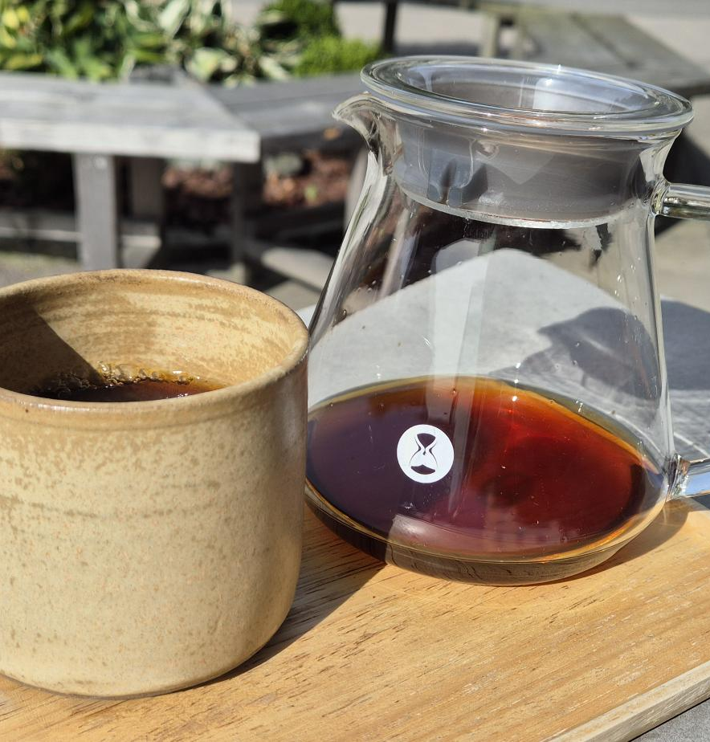




Learning How to Drink Better Coffee
Emanuel Palm Cloud Specialist, Coffee Nerd & Microsoft MVP @ Unwonted
@PalmEmanuel
Notes:
Introduction with a few comments about that it’s crazy that the organizers allowed me to do this presentation when it’s a .NET conference. “Right? Who would’ve thought they wanted a presentation on Java”

Slide 2

Notes:
It doesn’t have to be this way! At least for coffee, I can’t promise anything about the code. Especially if you decided to visit a session on Java.

Slide 3
My Coffee Journey
2020
ENJOYED COFFEE FOR THE FIRST TIME

Slide 5
My Coffee Journey
POWERSHELL CONFERENCE EUROPE 2023
2020
2023
2023
ENJOYED COFFEE FOR THE FIRST TIME
BOUGHT A COFFEE ROASTER
SWEDISH SPECIALTY COFFEE CAMP

Slide 6
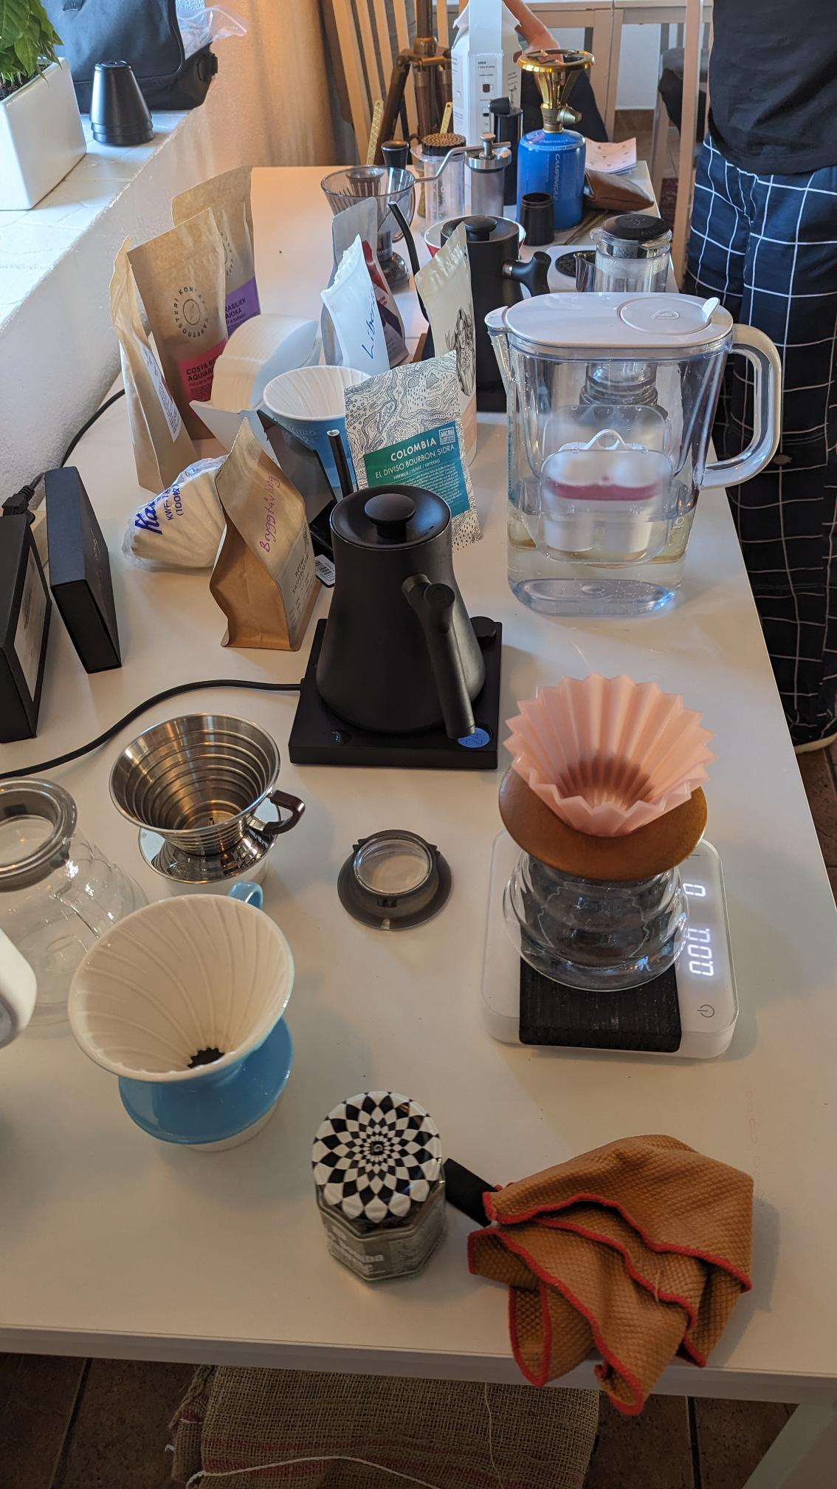
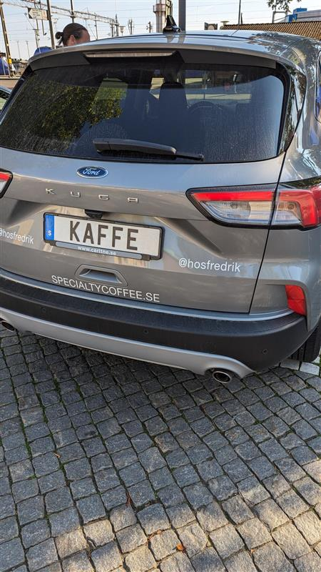
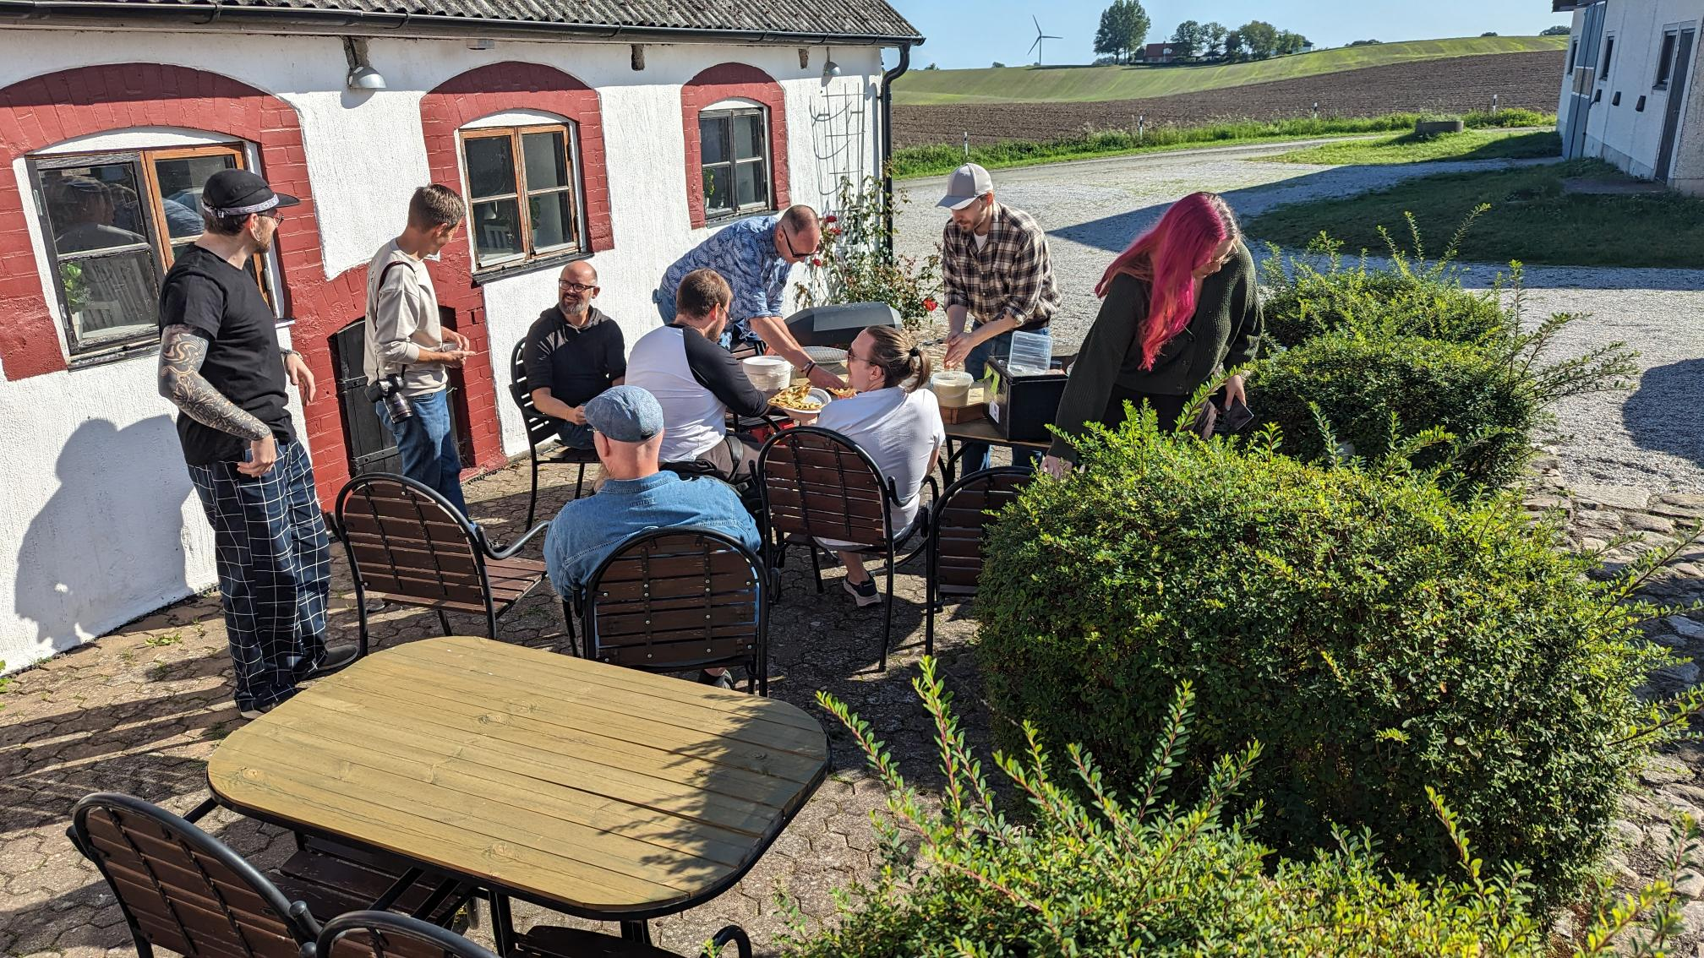
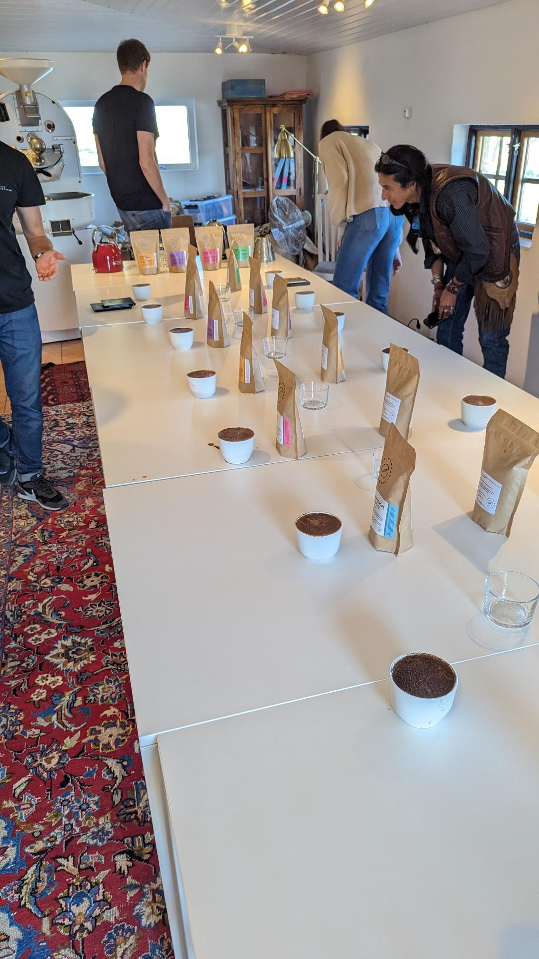

Slide 7
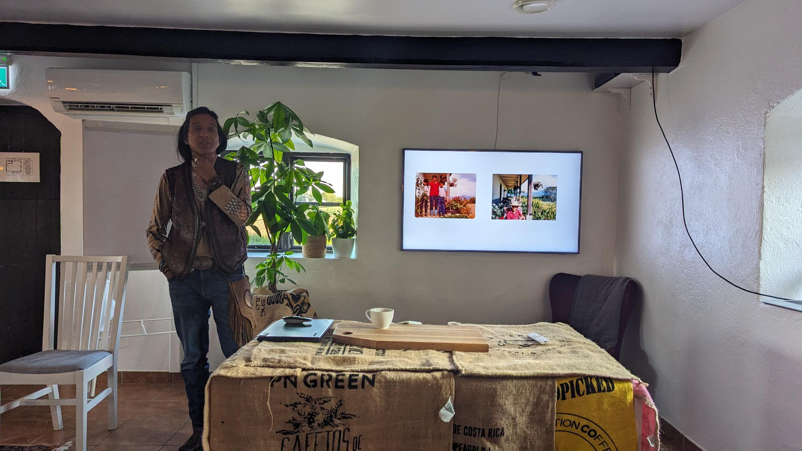

My Coffee Journey
Heber Sarria
Finca La Tierra

Slide 8

My Coffee Journey
POWERSHELL CONFERENCE EUROPE 2023
STARTED
2020
2023
2023
2024
ENJOYED COFFEE FOR THE FIRST TIME
BOUGHT A COFFEE ROASTER
SWEDISH SPECIALTY COFFEE CAMP

Slide 9


Slide 10





Git-based CMS
AppleScript
Static Site Generator
GitHub Pages
PowerShell
Cart & Checkout
Pixelmator Pro

Slide 11
My Coffee Journey
POWERSHELL CONFERENCE EUROPE 2023
STARTED
2020
2023
2026
2023
2024
ENJOYED COFFEE FOR THE FIRST TIME
BOUGHT A COFFEE ROASTER
SPEAKING ABOUT COFFEE AT SWETUGG STOCKHOLM
SWEDISH SPECIALTY COFFEE CAMP

Slide 12



Emanuel Palm
💙 Everything-as-Code
📦 Makes modules & tools
📃 Fan of Open Source
☁️ Blogs at pipe.how
Fun facts!
🧗 Bouldering & Climbing
🎲 Dungeons & Dragons
🥏 Disc Golf
🇸🇪
Cloud Specialist & Coffee Nerd
@PalmEmanuel

Slide 13
Agenda
Introduction to Specialty Coffee
From Farm to Cup
Live Brew
Key Takeaways (with a simple brew recipe)
Please ask questions along the way!

Slide 14





What is Specialty Coffee?
A coffee or coffee experience that is recognized for its distinctive attributes, resulting in a significantly higher value within the marketplace.
- Specialty Coffee Association (SCA)

Slide 15
What is Specialty Coffee?
Previous definition – 80+ on 100 point system
Aroma, Flavor, Acidity, Body etc 👍
Defects 👎
Certified Q-Graders – “Sommeliers for coffee”

Slide 16
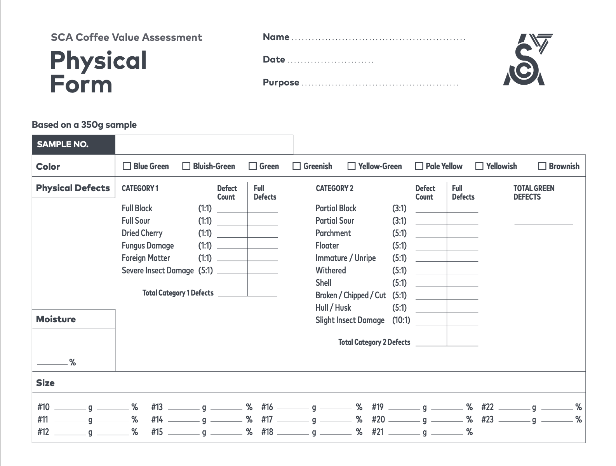

Slide 17
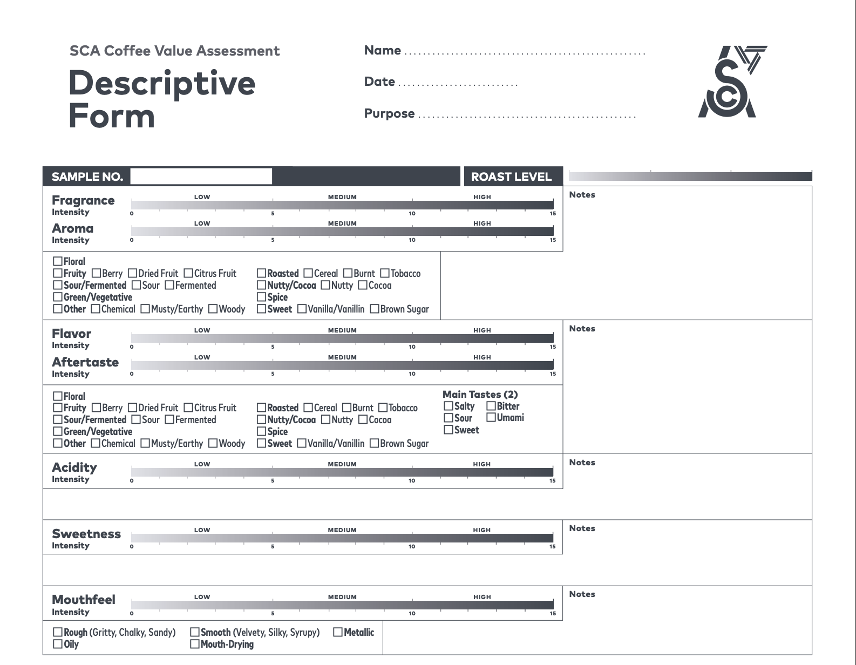

Slide 18
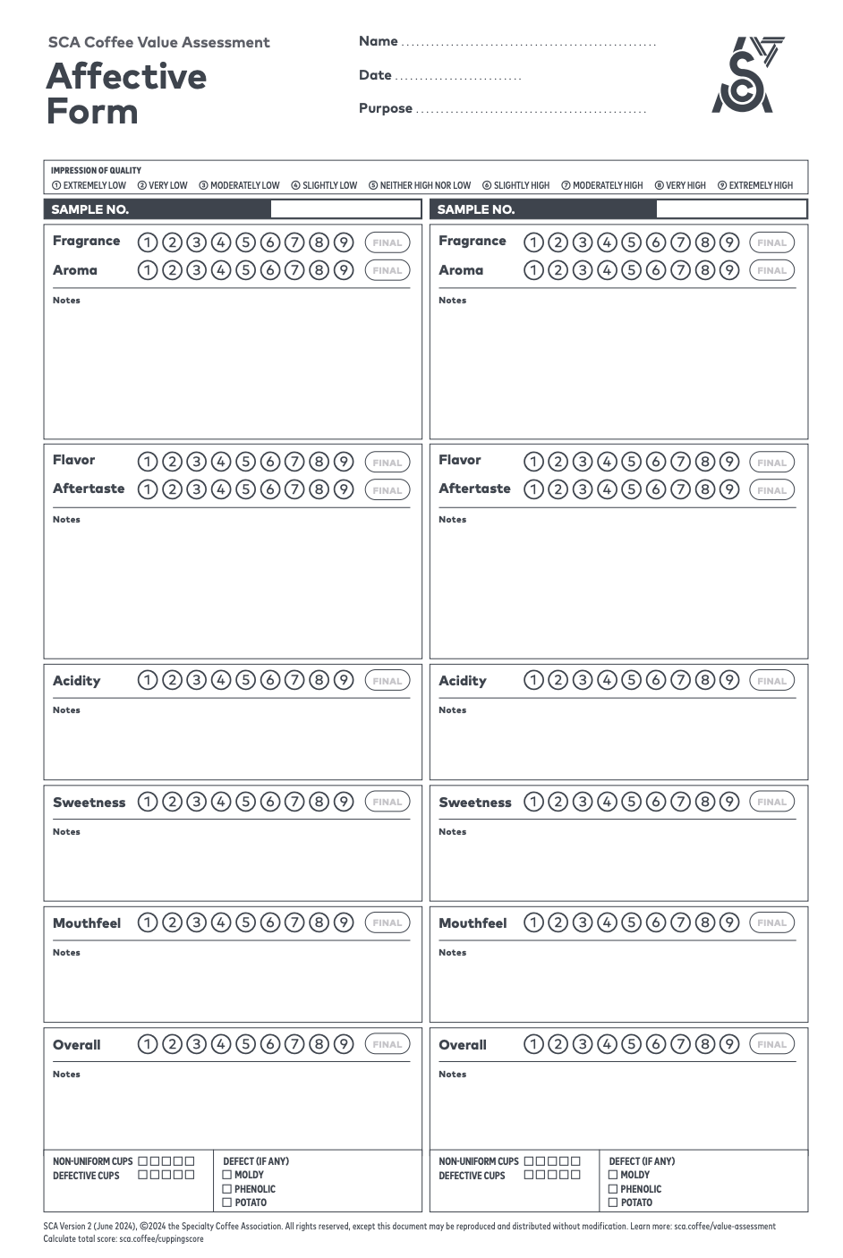

Slide 19
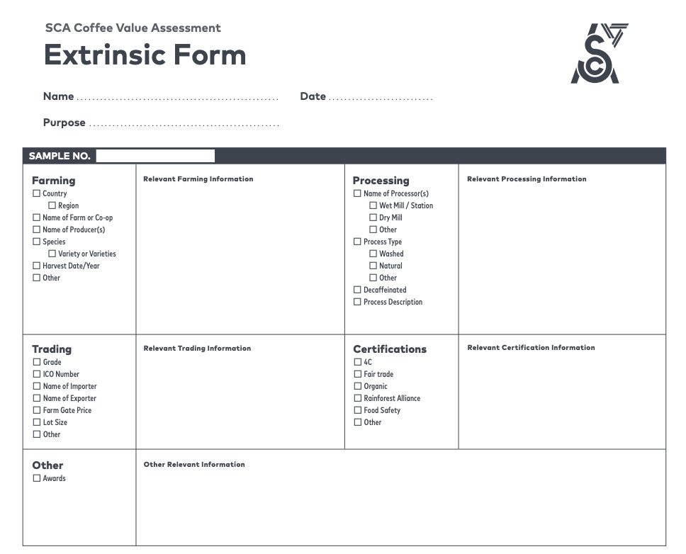

Slide 20
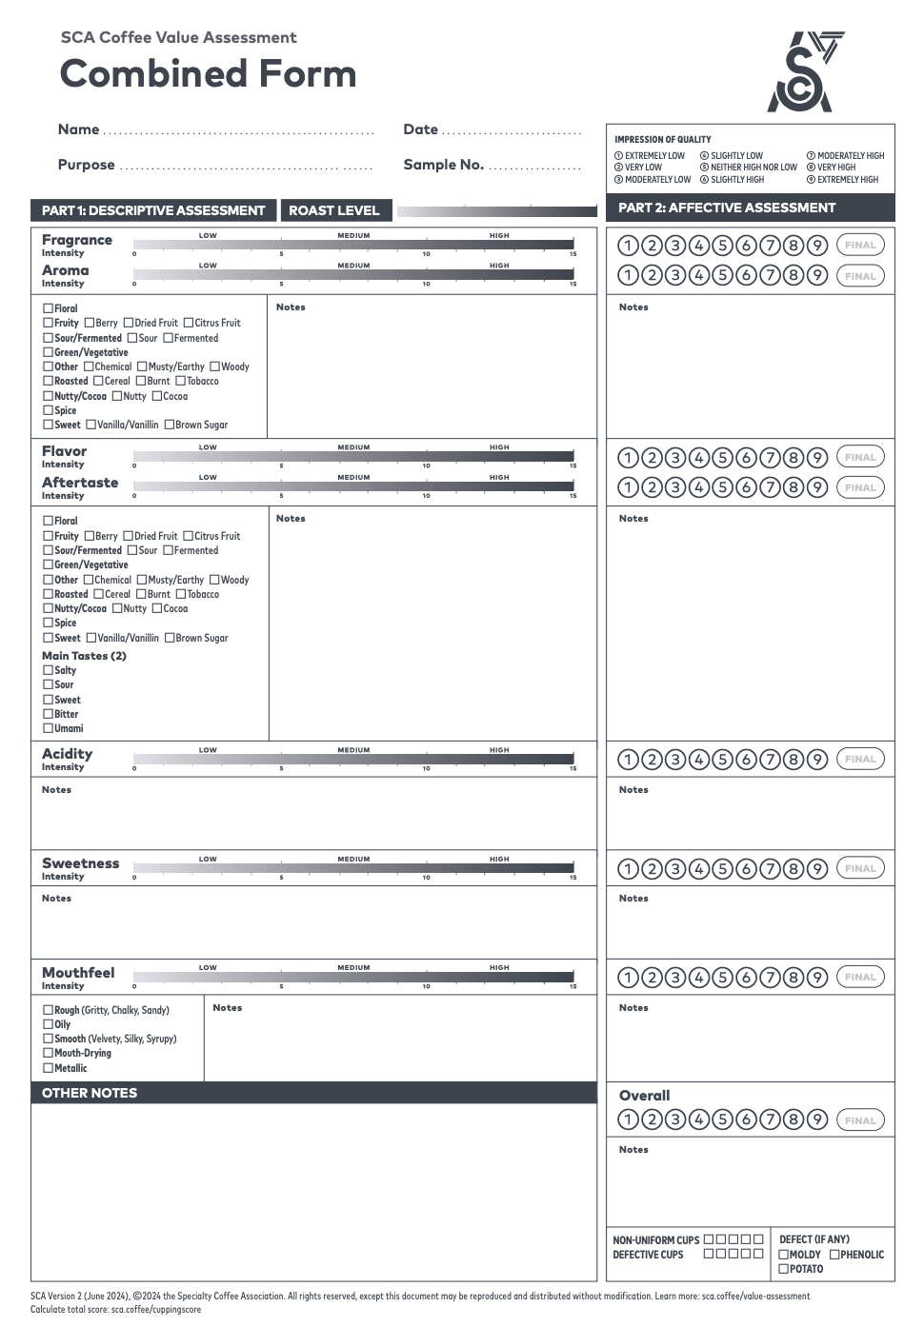

Slide 21
How do I know it’s Specialty Coffee?
More info is a good indicator
Roast date
Origin & Farm info
Process
Tasting notes
Varietal (not just Arabica)
& more

Slide 22

Coffee Farming
Section
01
Photo by Michael Burrows: https://www.pexels.com/photo/blooming-arabian-coffee-shrub-on-plantation-in-countryside-7125398/

Slide 23
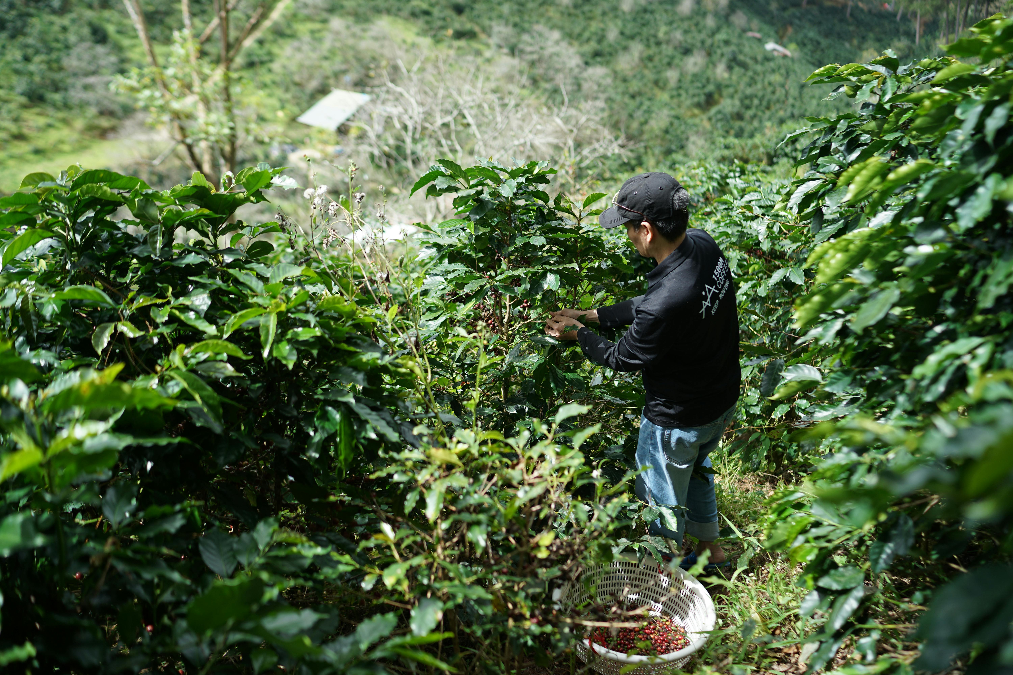
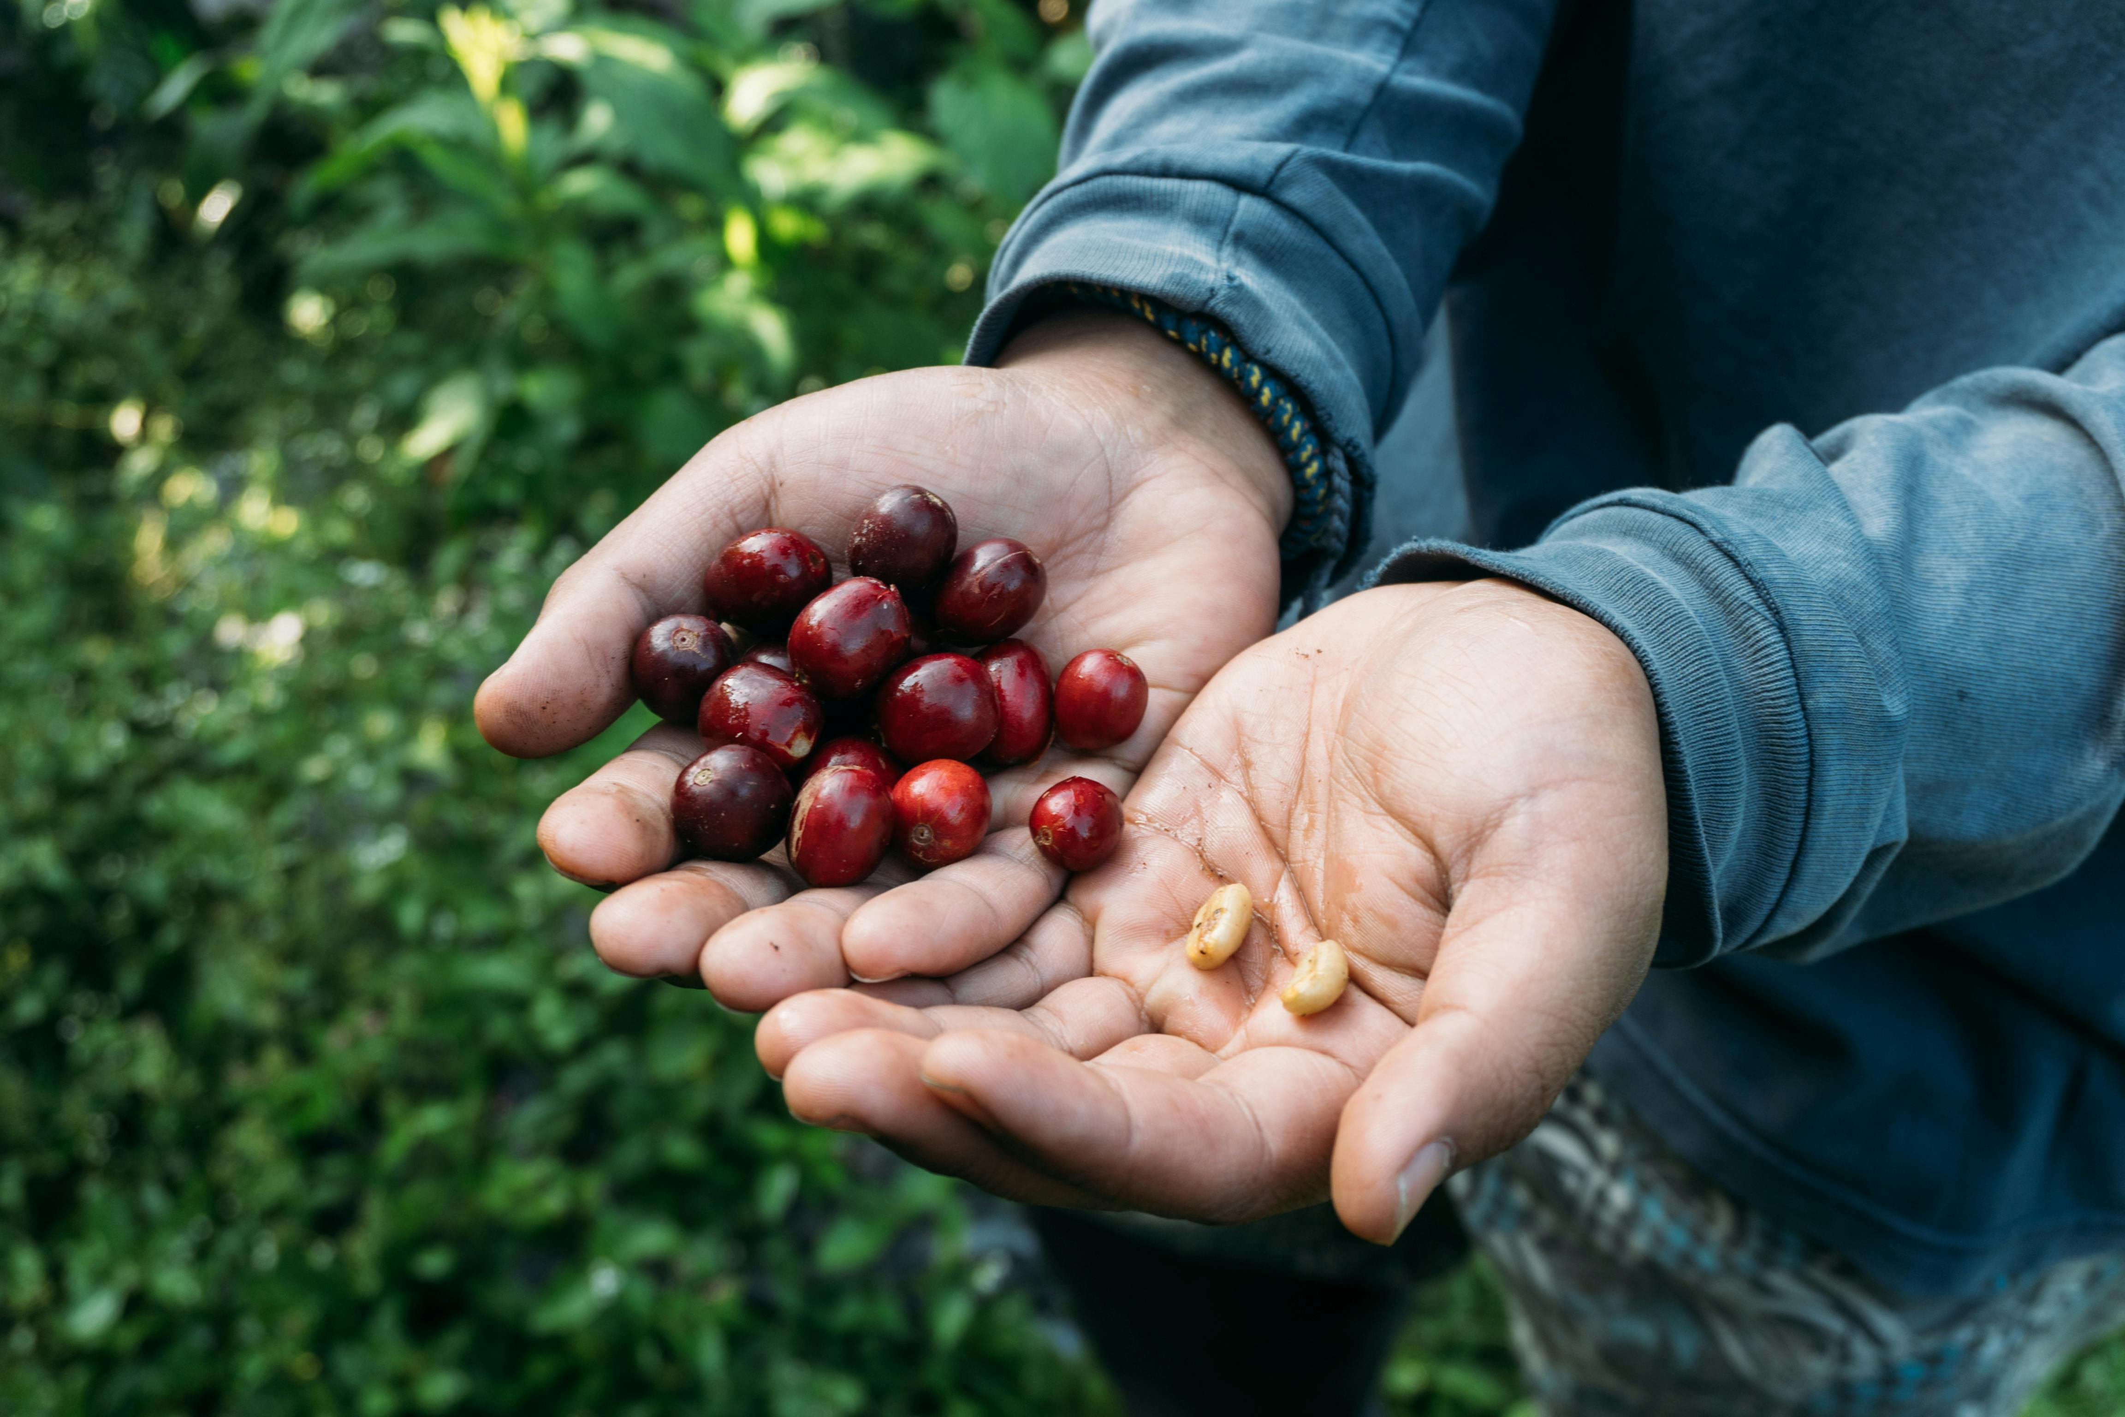
Farming
Coffee is a fruit
Plants grow 2~10 meters
Mostly harvested by hand
Machines pick less precisely
Mountains often aren’t flat
Farm environment matters
Photo by Keri Liwi: https://www.pexels.com/photo/close-up-of-hands-holding-fresh-coffee-cherries-and-beans-34411040/
Photo by 1500m Coffee: https://www.pexels.com/photo/coffee-farmer-harvesting-on-hill-plantation-30717831/

Slide 24
Where is Coffee Grown?
Insert map here

Slide 25
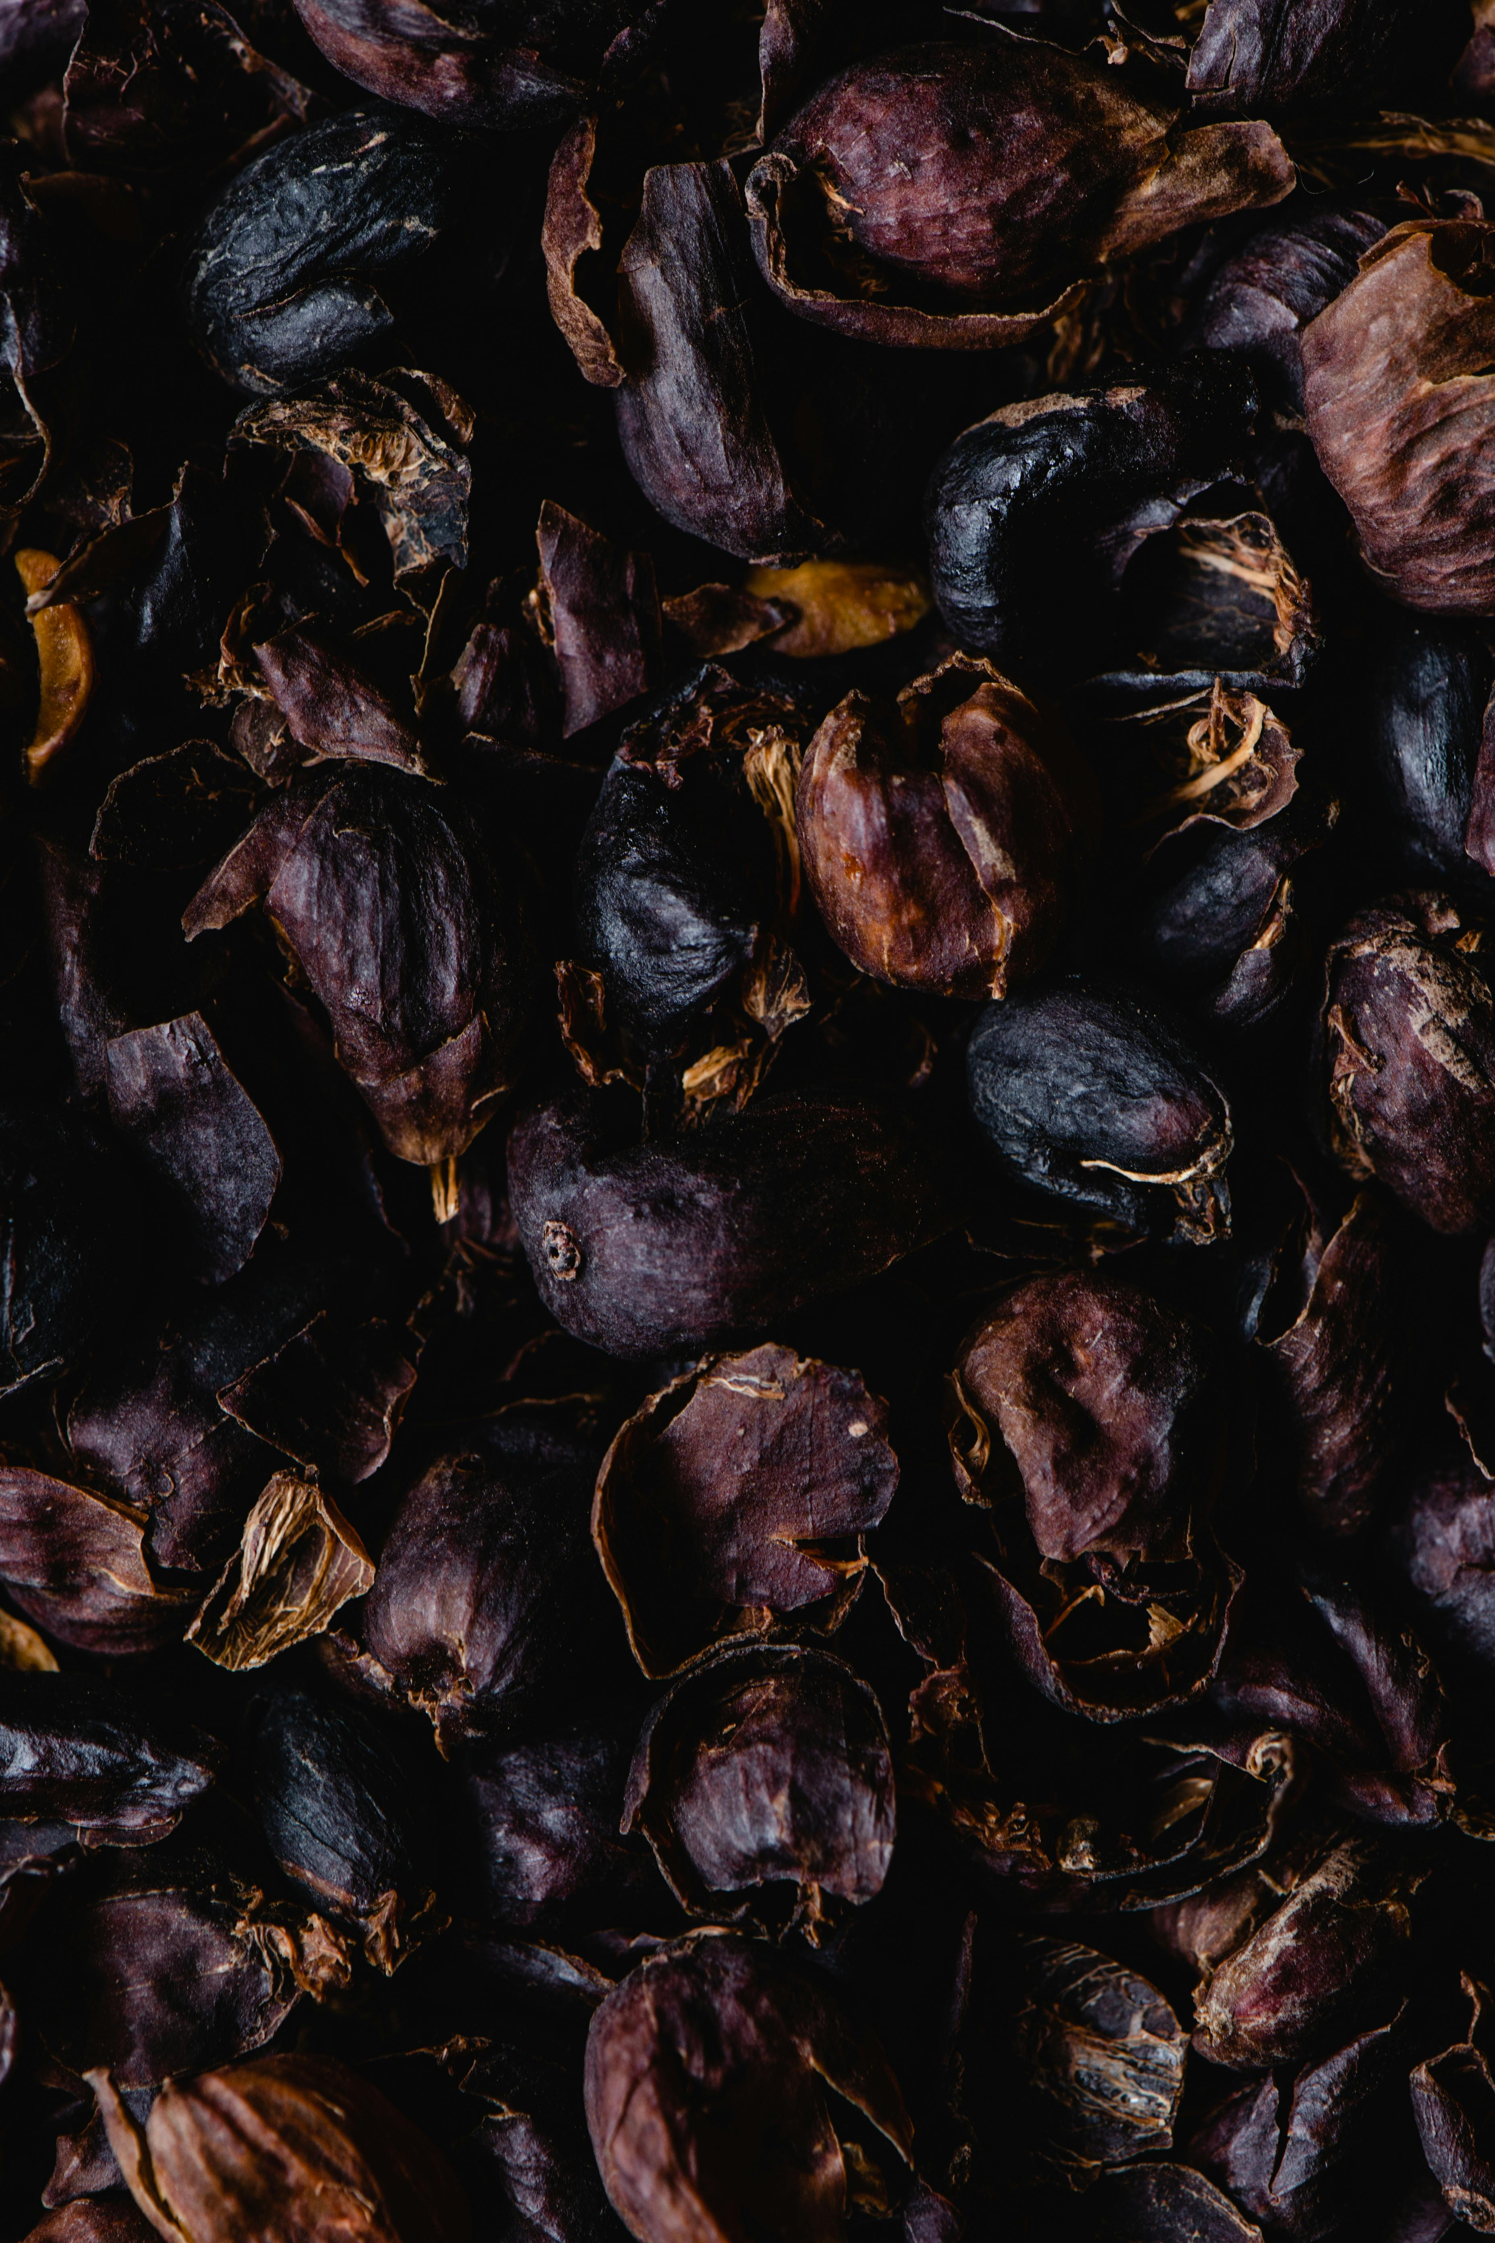
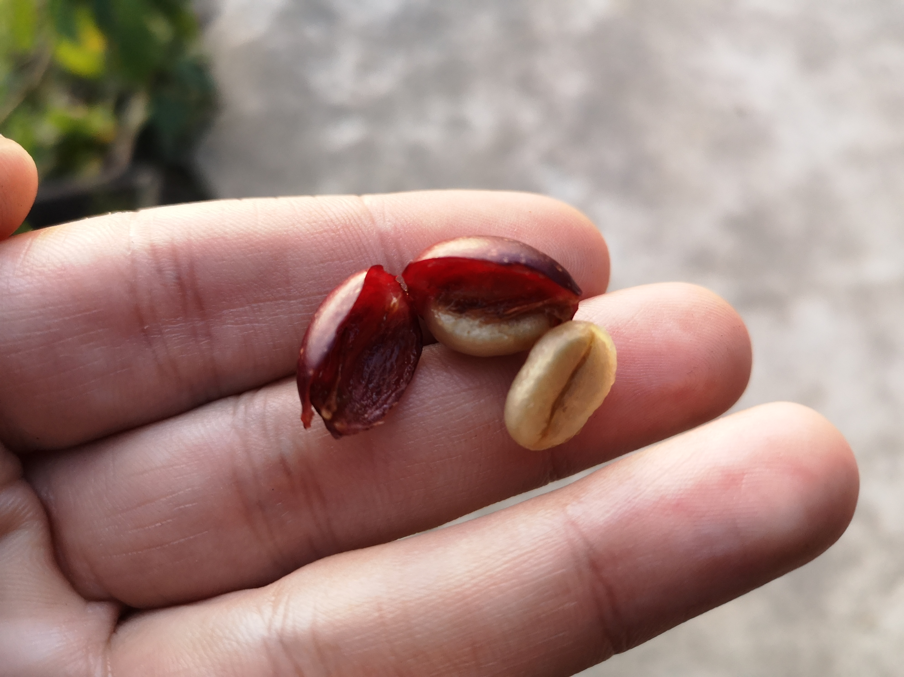

Leftover Pulp, Skin, Husk?
Photo: Huskee Cup, https://www.huskee.co/huskeeoriginal
Photo by Roger Burger
Photo by Eva Bronzini: https://www.pexels.com/photo/close-up-shot-of-dried-coffee-cherry-skin-6087516/

Slide 26
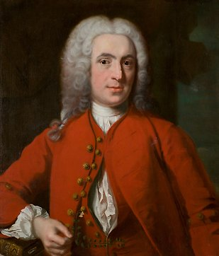
Varietals – “Arabica vs Robusta”
Coffea plant
Initially described by
Carl von Linné
…? Quiz time!
More reading: https://varieties.worldcoffeeresearch.org/

Slide 27
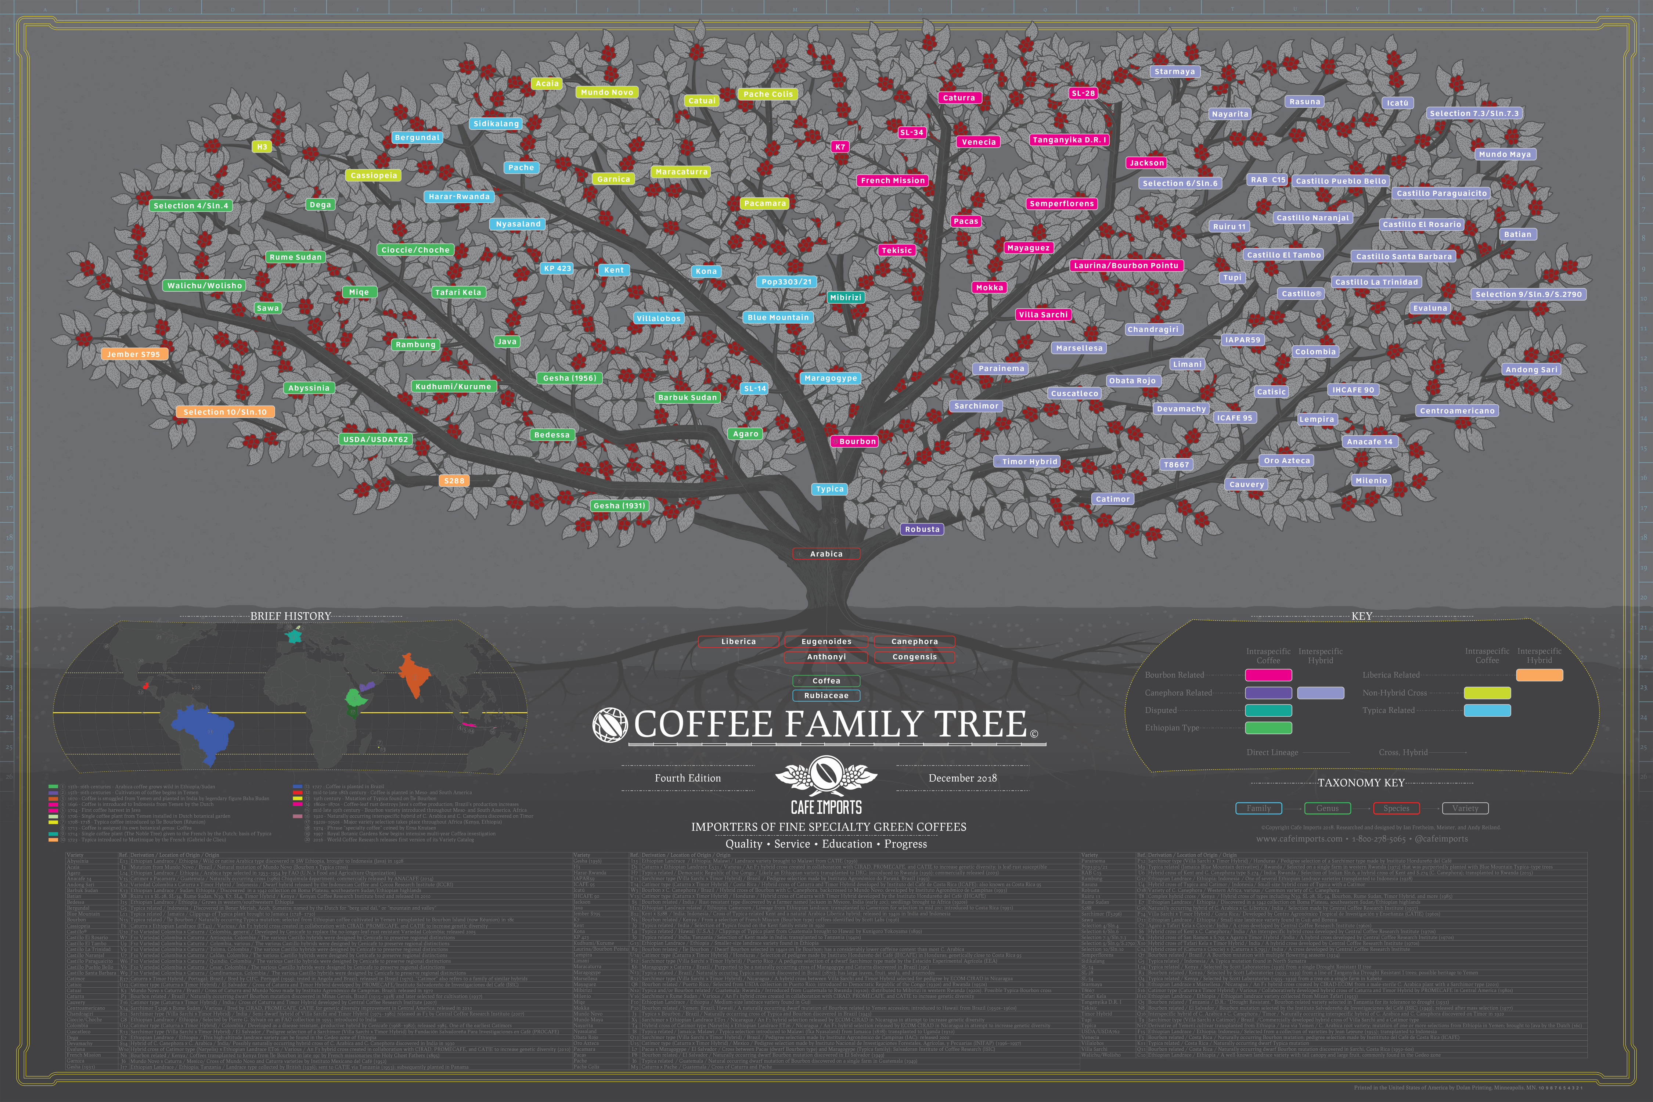
Source: https://www.cafeimports.com/europe/blog/coffee-family-tree/

Slide 30
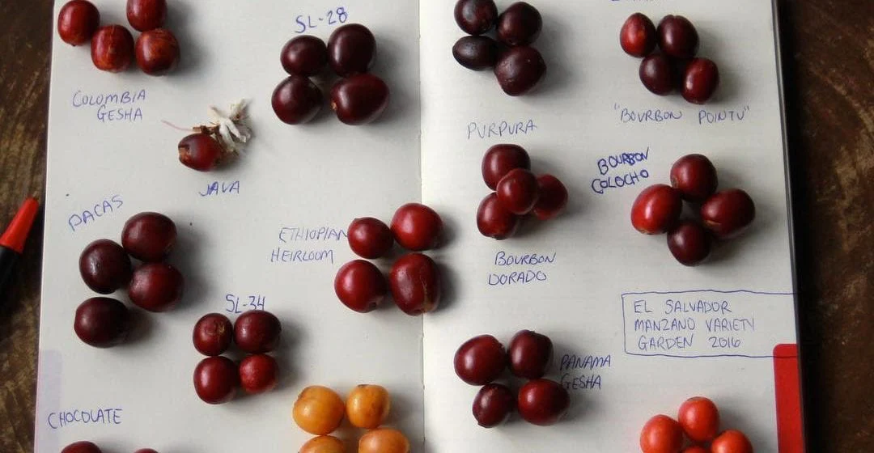
Photo: https://farocoffee.com/blogs/news/all-about-coffee-varieties

Slide 31
Varietals – “Arabica vs Robusta”
Coffea plant
Initially described by
Still finding new coffee species
Development of new coffee species
(No, not in Java)
Why?
Climate change
Yield
Leaf rust resilience
Carl von Linné
More reading: https://varieties.worldcoffeeresearch.org/

Slide 32
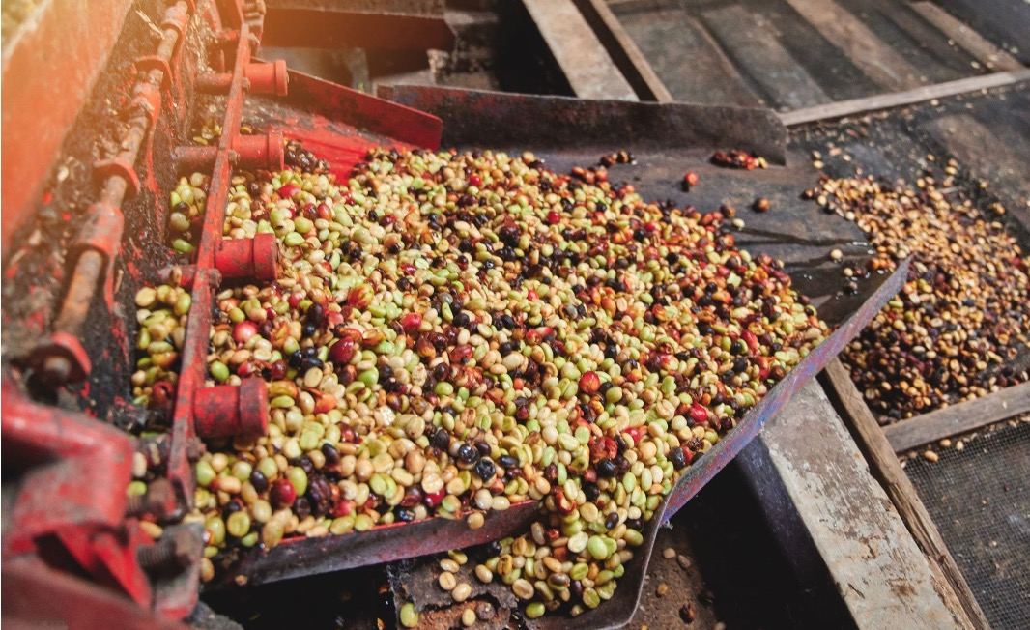
Coffee Processing
Section
02
Photo: https://chidoricoffee.com/blogs/coffee-blog/process-method-how-coffee-gets-processed

Slide 33
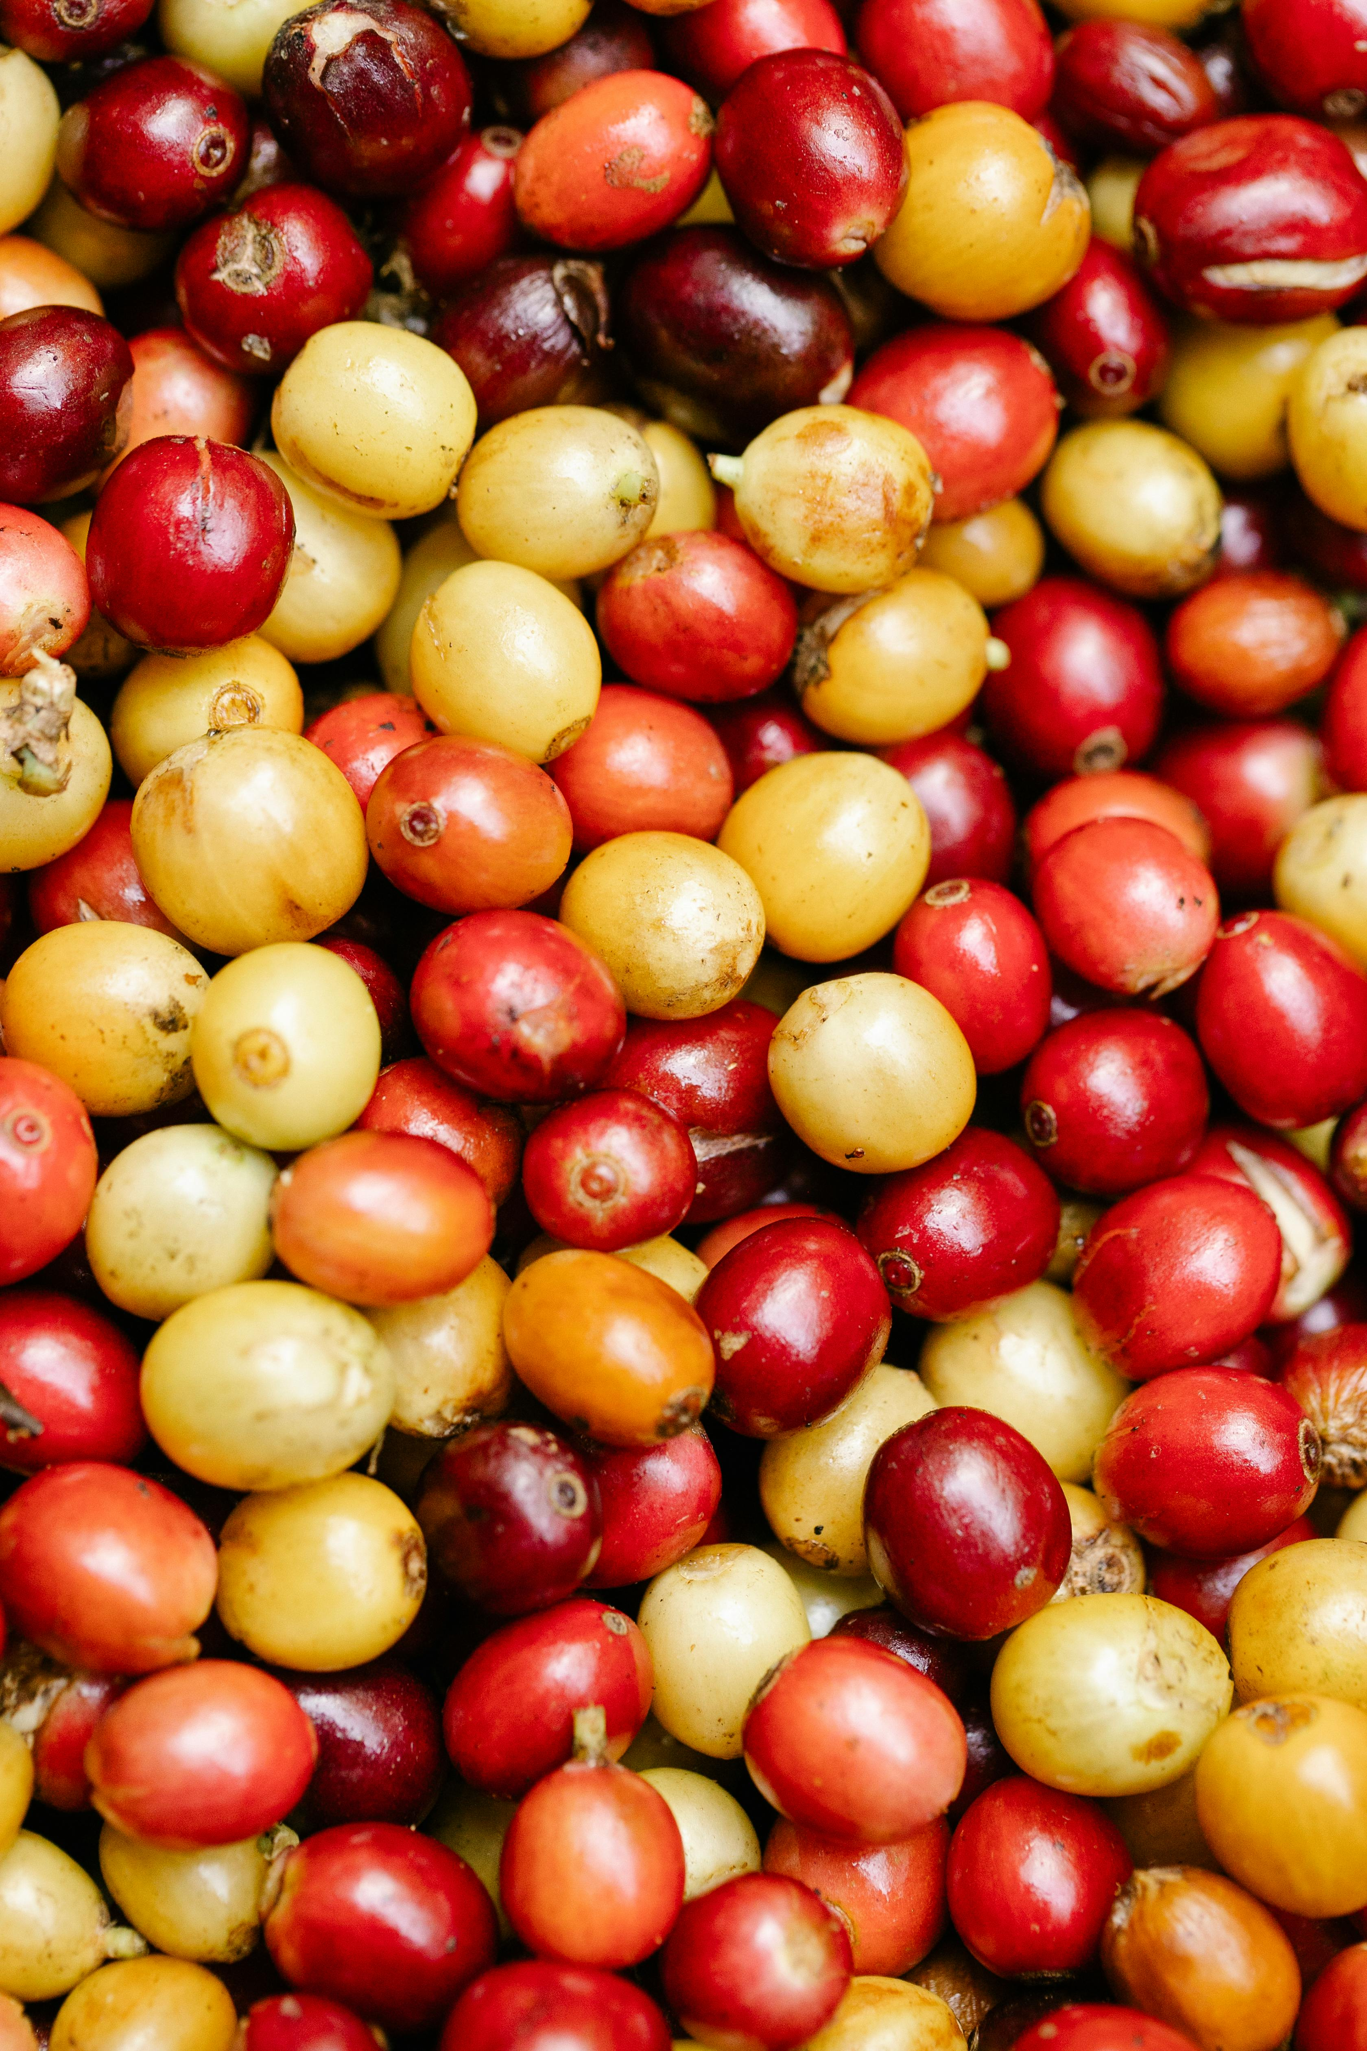
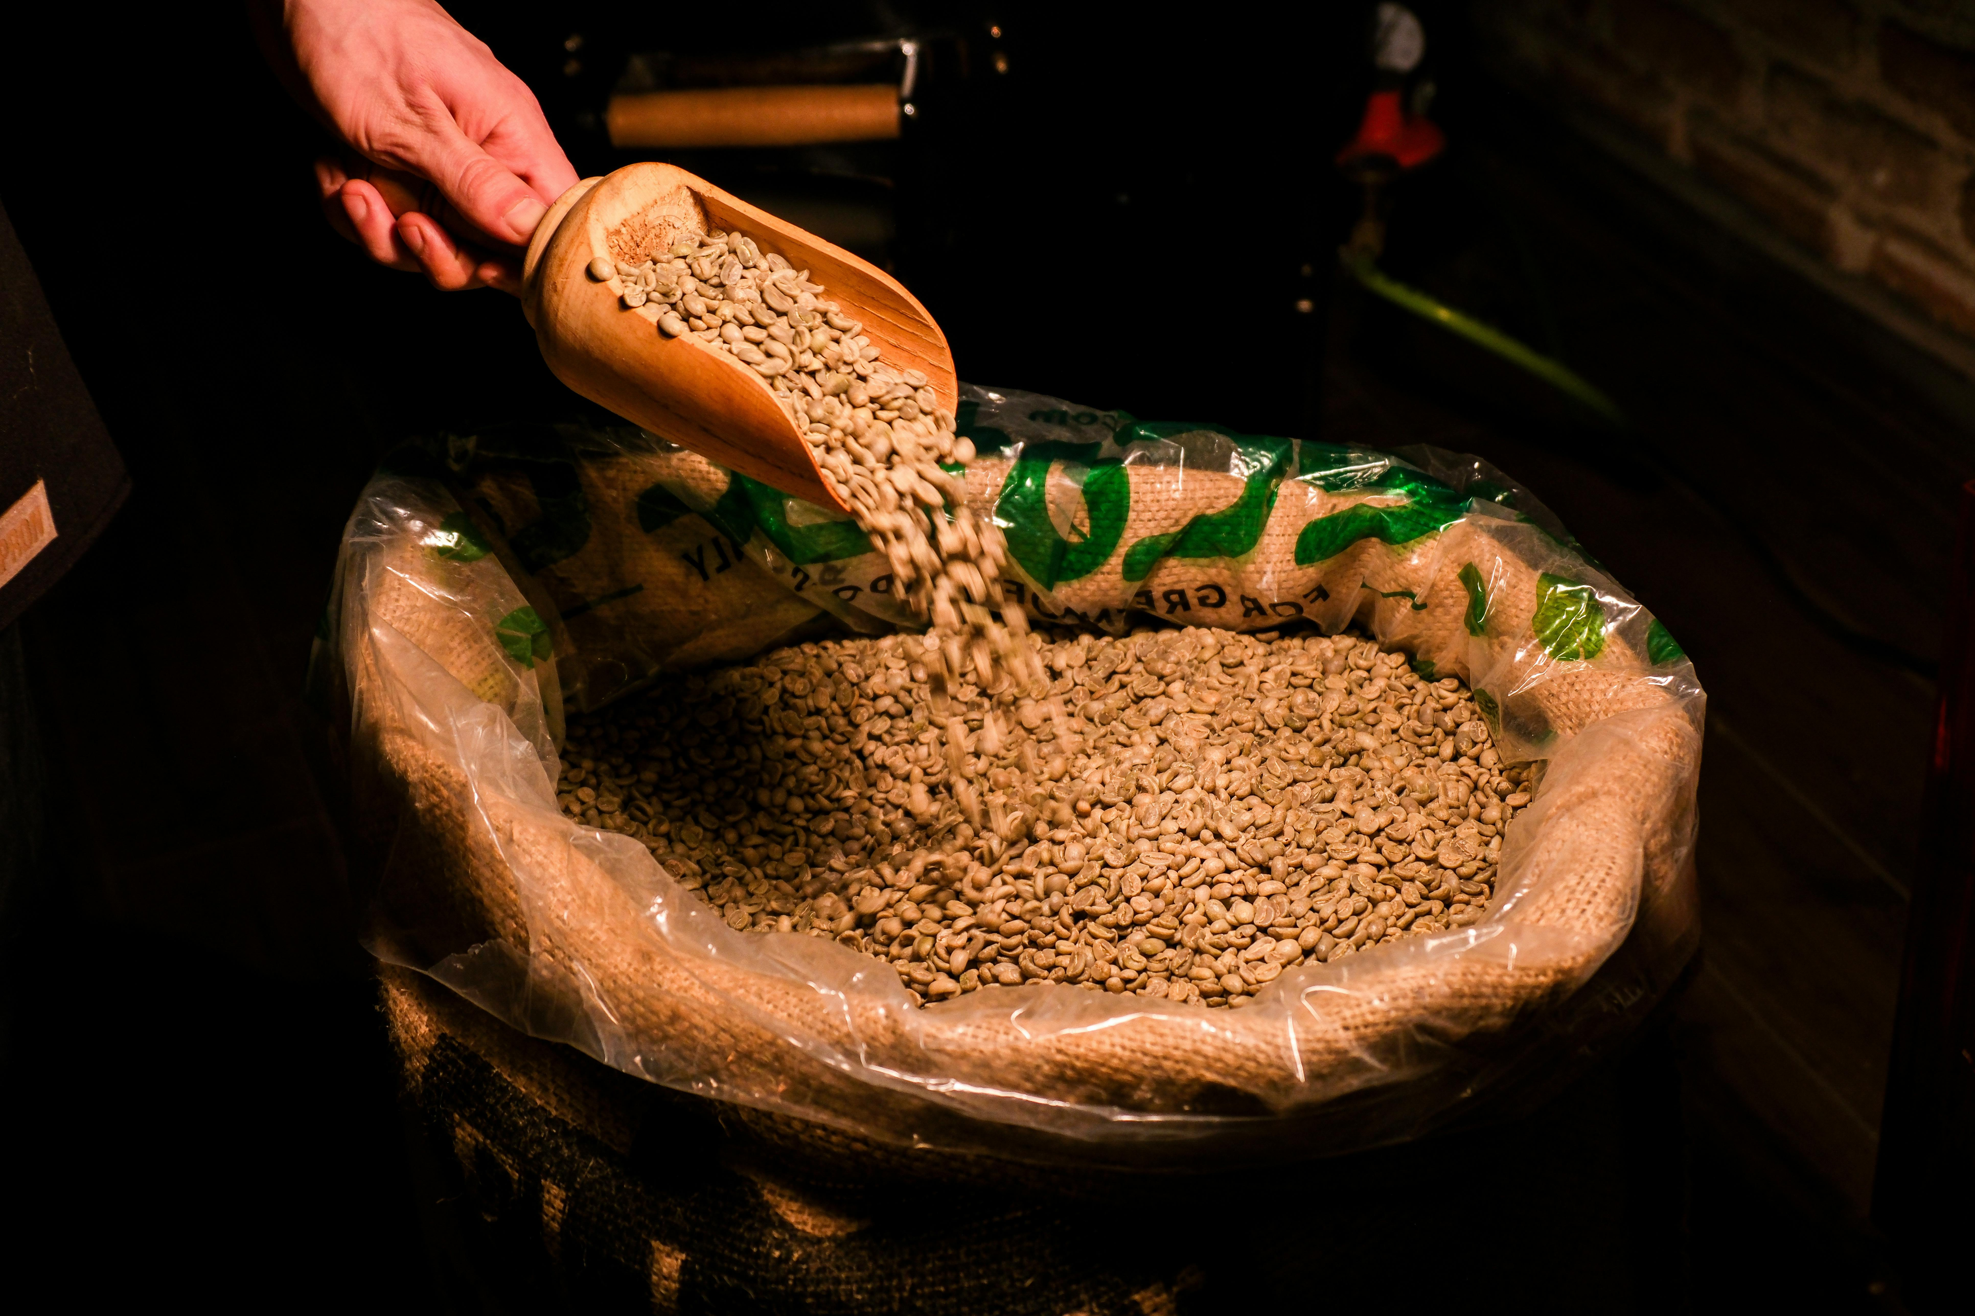


Coffee Processing
Photo by Ferhat E. Arslan: https://www.pexels.com/photo/scooping-raw-coffee-beans-into-burlap-sack-29873454/
Photo by Michael Burrows: https://www.pexels.com/photo/backdrop-of-assorted-coffee-fruits-with-pleasant-aroma-7125589/

Slide 34
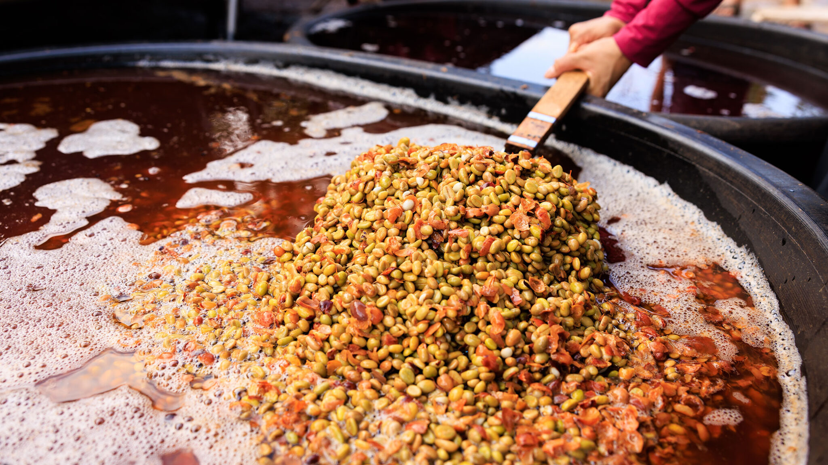
Washed Process
Coffee is washed
Photo: https://www.aboutcoffee.org/beans/processes/

Slide 35
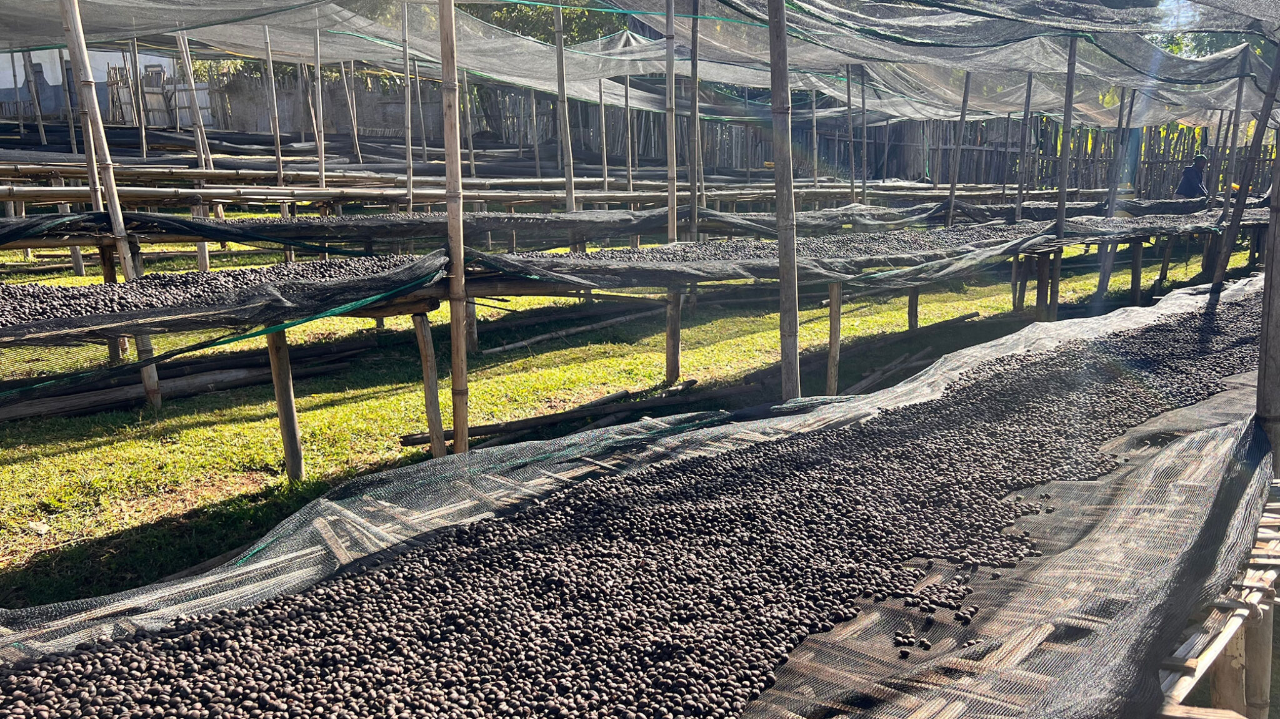
Natural (Dry Process)
Coffee is dried whole
Photo: https://www.aboutcoffee.org/beans/processes/

Slide 36
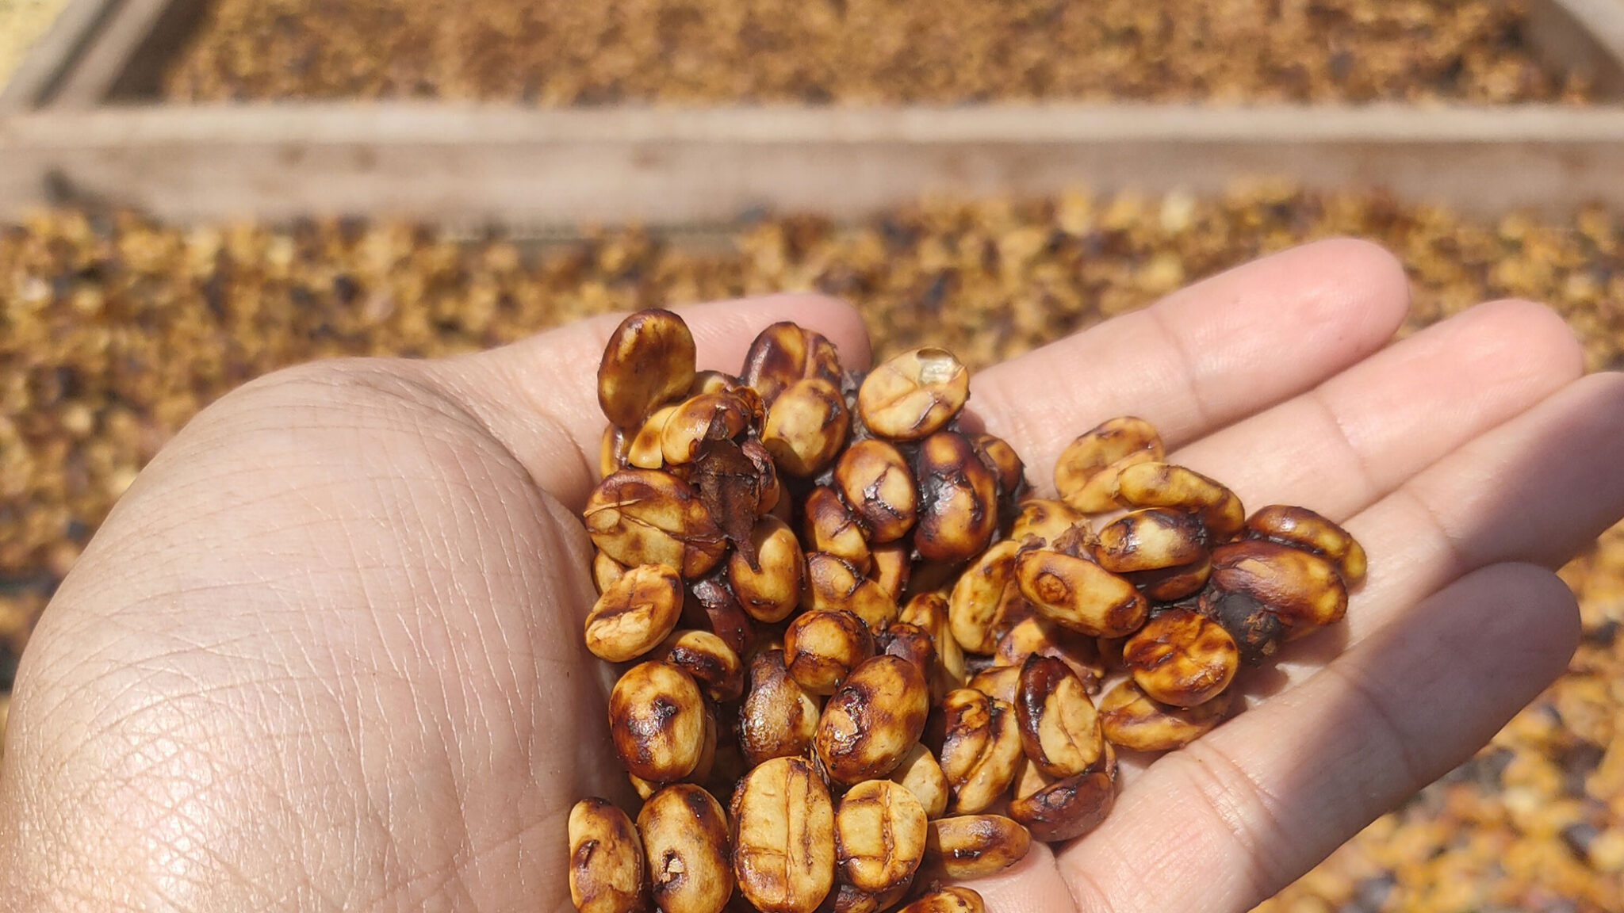
Honey Process
Black
Red
Yellow
White
Photo: https://www.aboutcoffee.org/beans/processes/

Slide 37
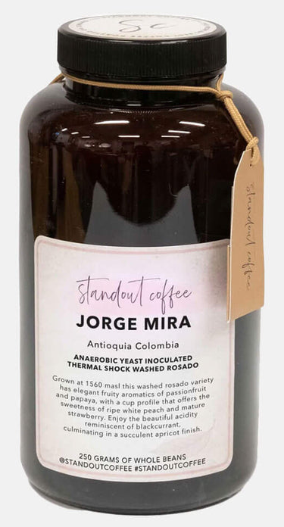
Flavors
Coffee vs Wine
Flavor compounds
“Analytical chemistry studies have identified on the order of over 1,000 volatile compounds in both roasted coffee and wine. However, in both beverages only a small proportion of these compounds are present above human odor thresholds and directly contribute to perceived aroma.”
Pretentiousness - Can feel elitist but I’d like to think it often comes from a desire to accurately describe the coffee with as much traceability as possible to give justice to the farm and the process, so let’s demystify it together today
Drinking temperature, flavor perception

Slide 38
(The Market)
Show map of where coffee is grown
Harvests and prices affected by politics, conflicts, climate, supply chains

Slide 39
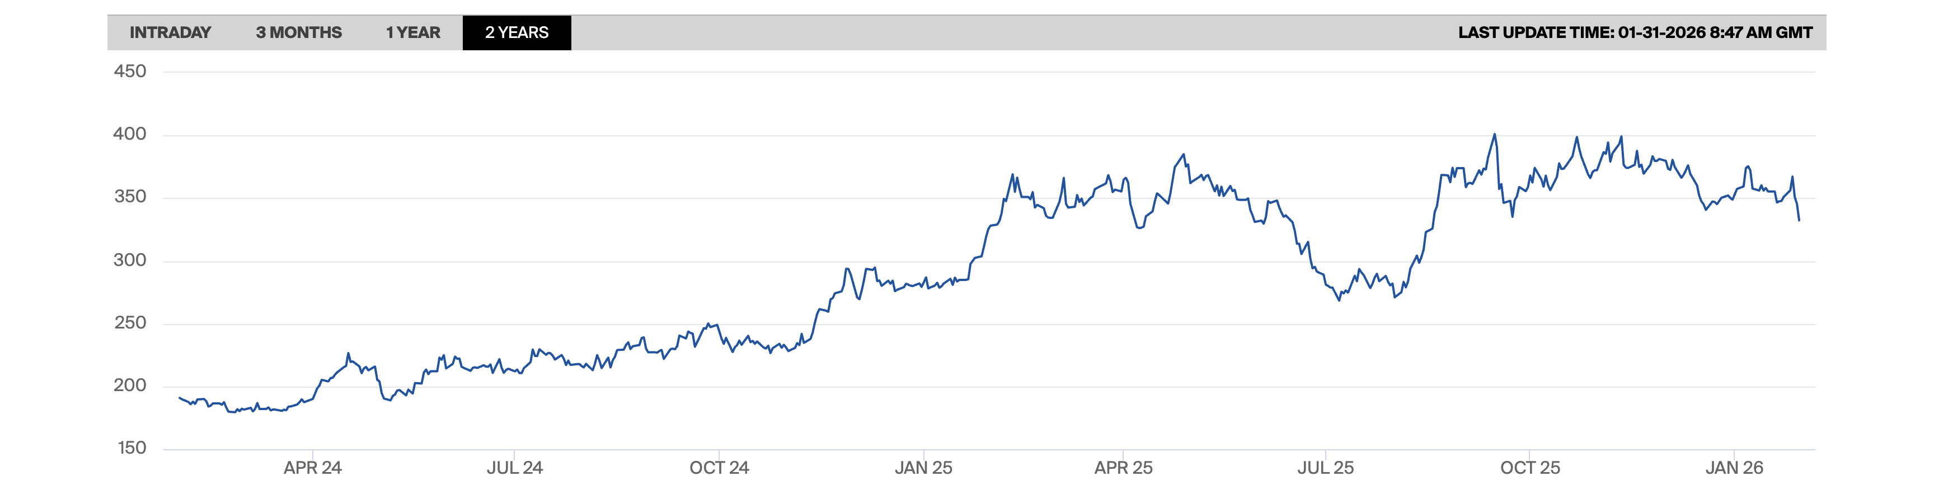

What is Specialty Coffee?
Commodity / Commercial coffee - “C Price”
Global benchmark for Arabica
Supply chain, climate, politics

Slide 40
Roasting
Freshness from roast

Slide 41
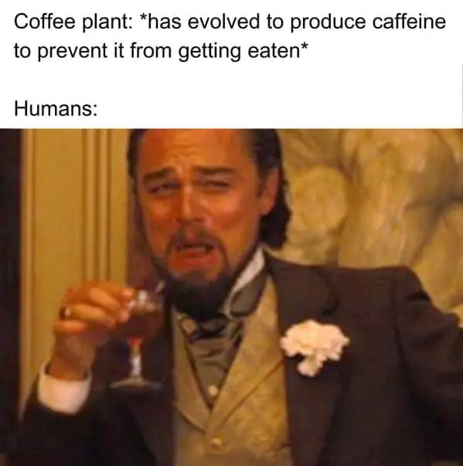
Caffeine
Caffeine is bitter
Light vs dark roast? volume vs weight in roast level
Arabica vs Robusta (robusta has more)
Caffeine comparisons? (James Hoffman video? It varies extremely widely in cafés
What about decaf?

Slide 42
Instant Coffee?
Exists in specialty coffee too, though much more rare

Slide 43
Grinding
Freshness from grind

Slide 44
Brewing
Different brewing mechanisms and brewers, immersion, percolation, bypass
Comparison pictures of brewers
Techniques and tips, RDT
Temperature?
Over- and underextraction, acidity extracts first then bitterness

Slide 45
I just want a good cup of coffee - Variables
(pop up pictures with text one by one, pick out three in order at the end)
Beans
Process method
Varietal
Farm elevation
Roast level
Roast style / profile
Grinder
Burr types
Water
Water minerals
Filter type
Filter paper (if paper)
Pouring technique
Amount of agitation
Number of pours
Brewer
Brewing vessel
Material
Time
Dose
Ratio
Brewing temperature
Drinking temperature
Cup form (drinking)

Slide 46
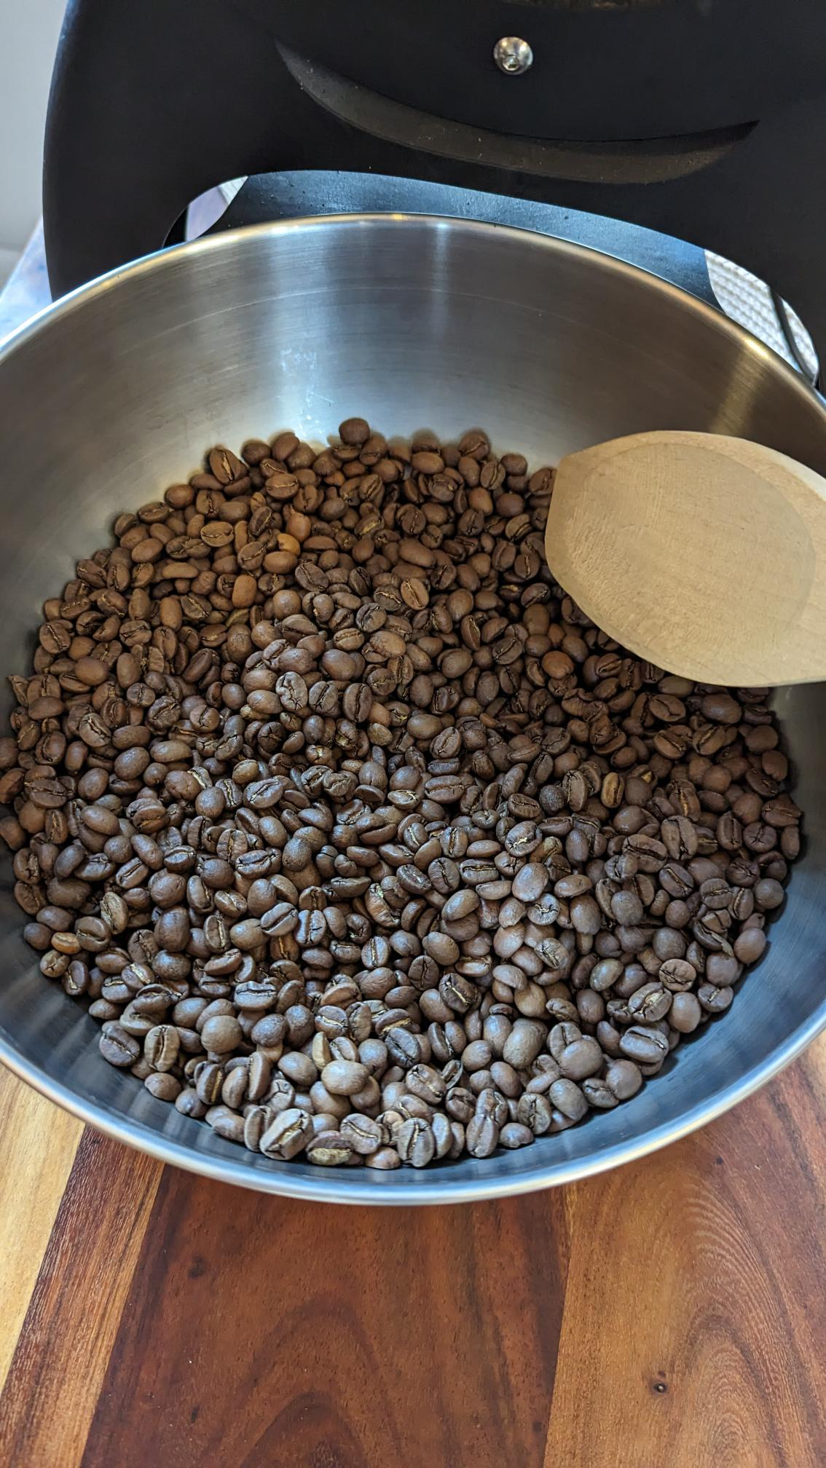
Beans
Photo: Me

Slide 47

Processing Method
Photo: https://chidoricoffee.com/blogs/coffee-blog/process-method-how-coffee-gets-processed

Slide 48
Varietal
Photo: https://farocoffee.com/blogs/news/all-about-coffee-varieties

Slide 49
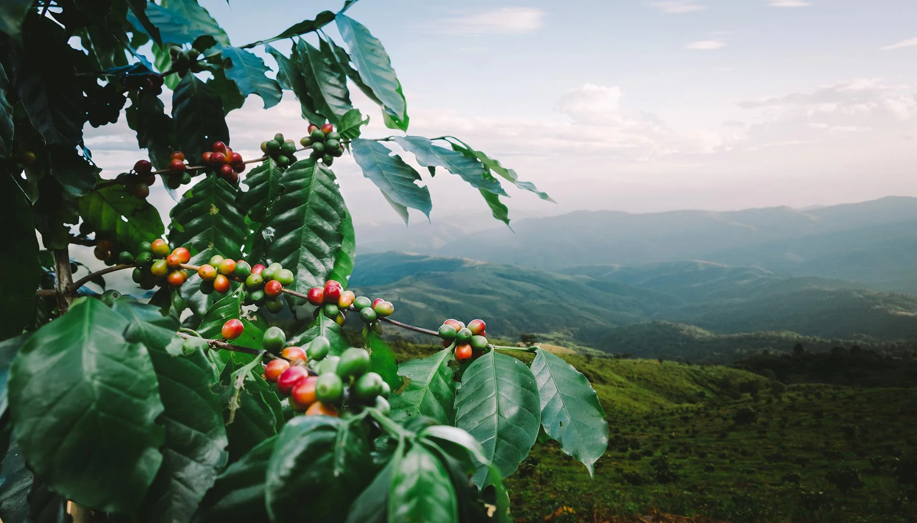
Altitude
Photo: https://kofficoffee.com/collections/single-origins

Slide 50
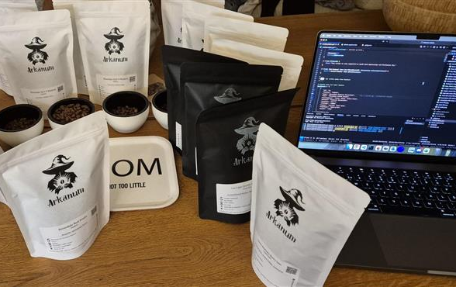
Demo Time
Example brew recipe on screen 500ml? 1L?
Equipment needed?

Slide 51
Takeaways
Is the coffee good, and is it “good” coffee? (does it have information about the country, region, farm, varietal, process, harvest period etc?)
Top 3 things to focus on
[A brew recipe]
@PalmEmanuel

Slide 52
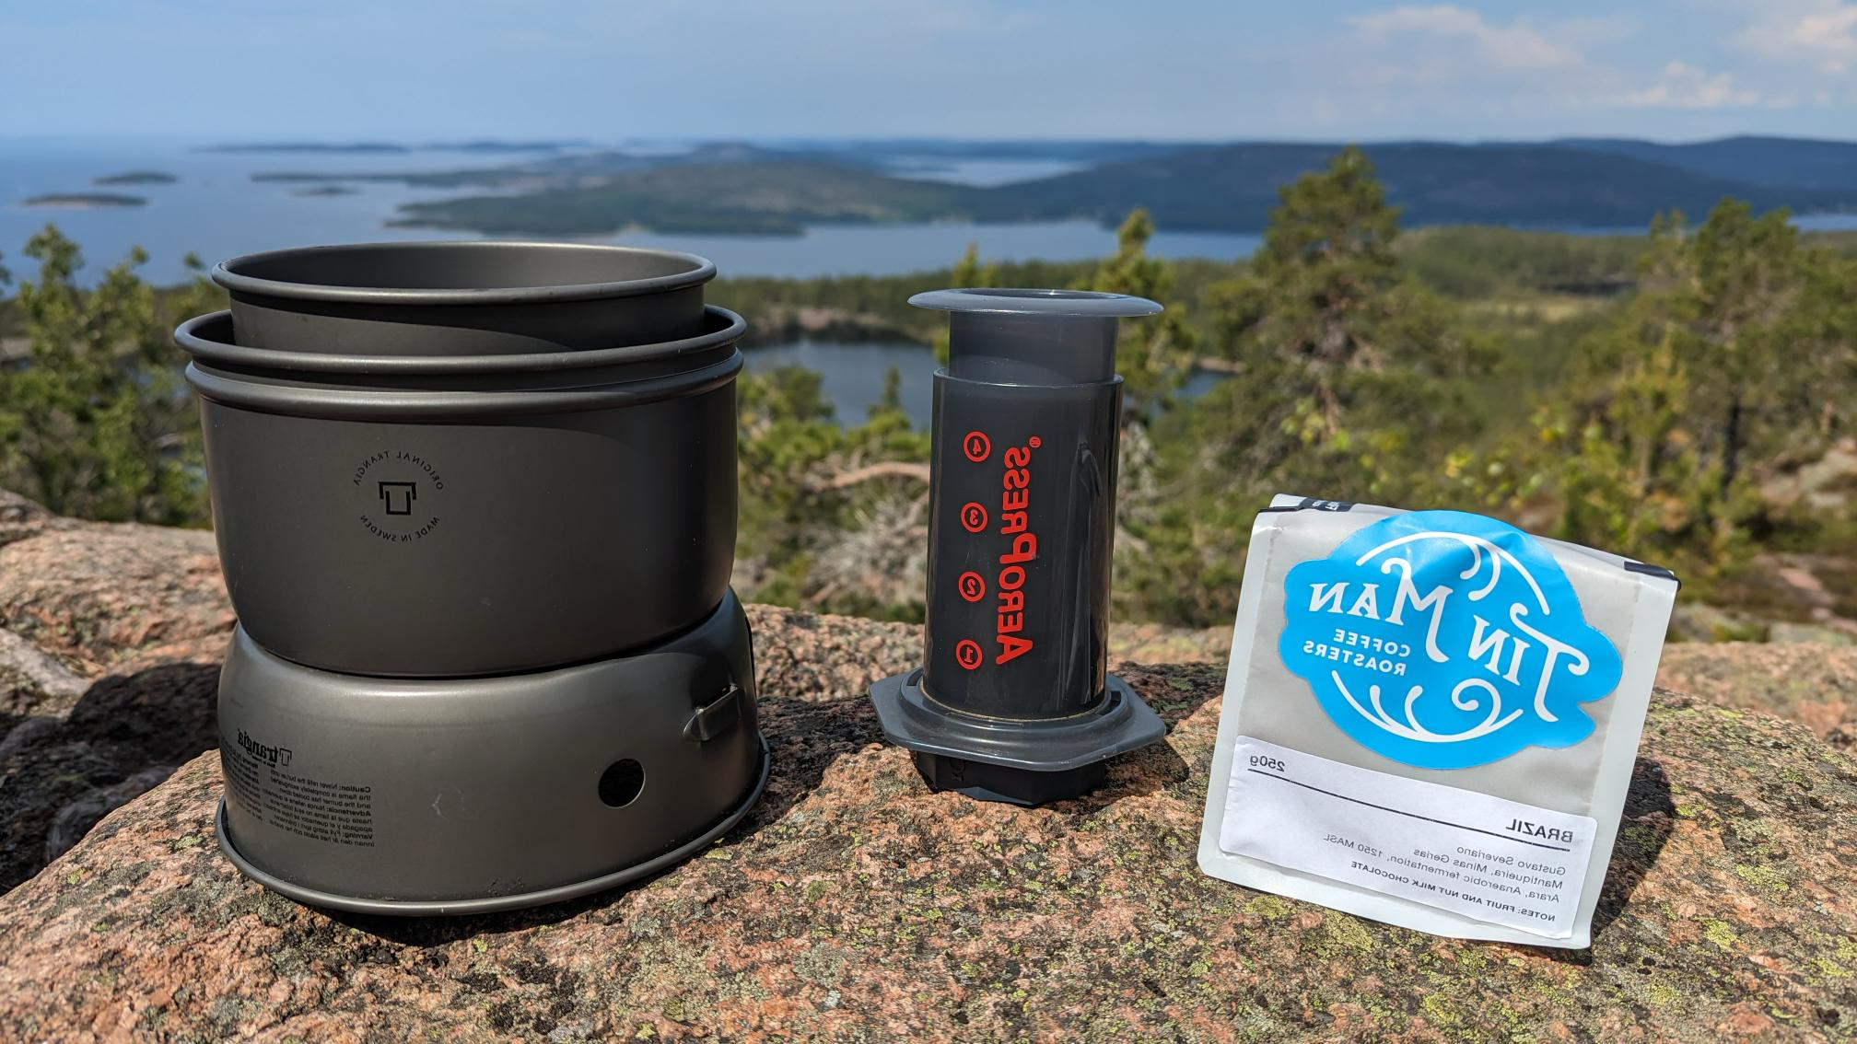


Thank you!
@PalmEmanuel
@arkanum.coffee

